Slide 1
Thread and Process Communication
Lecture 1 of 3
Data Pools
Note: Examples of the concepts presented here can be found in the RTExamples folder: Q3 & Q5
You are encouraged to open the project(s) in Visual Studio and run the program(s)
©Paul Davies 2020. Not to be copied, used, or revised without explicit written permission from the copyright owner. This lecture may contain animations and is best viewed as a slide show

Slide 2
Introduction
We saw last week than when hierarchical process/thread decomposition is applied to break down a complex software system into a number of smaller tasks, it is reasonable to expect that those processes and threads will wish to communicate with each other. This also creates problems with data synchronisation, i.e. how do we know when data has been generated or updated?
See http://en.wikipedia.org/wiki/Inter-process_communication
Process/Thread
Thread
Process/Thread
Thread
Process/Thread
Thread
Communication Problems
Synchronisation Problems
Process/Thread
Process/Thread
Thread
Thread
Process/Thread
Thread

Slide 3
Easiest Approach - Inter-Thread Communication
Inter thread communication is pretty straight forward when those threads are part of the same process because they have access to the same global variables as all other threads in that process.
Note synchronisation between communicating threads may still be needed i.e. when does one thread knows that another thread has generated data for it etc.
However thread communication across a process boundary i.e. two threads from two separate processes, must be treated in the same way as process to process communication – see later.
Example Q5 (from the RTExamples folder on Canvas) demonstrates inter-thread communication (within the same process) using global variables.

Slide 4
// Three global variables that both parent and child thread can directly share and access
// Because Parent and Child and the global variables are declared as part of the same process
int floor ; // floor corresponding to lifts current position
int direction ; // direction of travel of lift
int floors[10] ; // an array representing the floors and whether requests are set
UINT _ _stdcall ChildThread ( void *args )
{
cout << "Child Read value for Floor = " << floor << "\n";
cout << "Child Read value for Direction = " << direction <<"\n";
cout << "Child Read values for floor array = ";
for (int i=0; i < 10; i ++)
cout << floors[ i ] ;
return 0 ;
}
// end of structure template
int main( ) {
floor = 55 ; // store 55 into the variable 'floor'
direction = 1 ; // store 1 into the variable 'direction'
cout << "Parent Writing value '0 1 2 3 4 5 6 7 8 9' to floors array.....\n" ;
for (int i = 0; i < 10; i ++)
floors[ i ] = i ;
CThread c1( ChildThread , ACTIVE, NULL) ; // create child thread
. . .
c1.WaitForThread() ; // wait for the child thread to Terminate
return 0 ;
}
{
Process wide Global Variables
{
Child Thread
{
Parent Process Main Thread
Easy Inter thread communication using Global variables (see Q5 in RTExamples programs)

Slide 5
Similarly, threads within an active object can share data with the other threads in that object by using variables declared within the class.
class MyActiveClass : public ActiveClass
{
private : int floor , direction, floors[10]
public: void MyChildThread (void *args) {
cout << "Child Read value for Floor = " << floor << "\n";
cout << "Child Read value for Direction = " << direction <<"\n";
cout << "Child Read values for floor array = ";
for (i=0; i < 10; i ++)
cout << floors[ i ] ;
}
private: int main( ) {
floor = 55 ; // store 55 into the variable 'floor'
direction = 1 ; // store 1 into the variable 'direction'
cout << "Parent Writing value '0 1 2 3 4 5 6 7 8 9' to floors array.....\n" ;
for (int i = 0; i < 10; i ++)
floors[ i ] = i ;
// create child thread then wait for it to finish
. . .
Thread1.WaitForThread() ; // wait for the child thread to Terminate
return 0 ;
}
}
Class variables sharable between all threads in class
Active Class Child thread
Active Class Main thread

Slide 6
Inter-Process/Thread communication across a Process Boundary

Slide 7
Inter-Process Communication using Shared Memory
When attempting for the first time to implement inter-process communication (or thread communication across a process boundary), a novice programmer could be forgiven for attempting to share memory using global variables inside each process, as shown below.
(See: http://en.wikipedia.org/wiki/Shared_memory )
int var1 ; // a global integer variable declared inside Process 1
void main() // process main thread
{
. . .
var1 = 5 ; // store data into var1 for other process to read
. . .
}
int var1 ; // a global integer variable declared inside Process 2
void main() // Process main thread
{
. . .
int x = var1 ; // read data from var1
. . .
}
Program1.c
Program2.c
Why doesn’t this work, i.e. why can’t the two processes share data?

Slide 8
Problems with this Approach
Although the variable 'var1' defined in both Program 1 and 2 above is a global variable, it is however 'local' or 'private' to the program in which it is defined.
That is to say, that the variable 'var1' defined in program 1 is a completely distinct and separate variable from the variable 'var1' defined in program 2, even though they have the same name and data type.
Thus when program 1 stores data into 'var1' it is storing it into a variable which is private and self contained to that process which cannot be accessed by code in program 2.
When program 2 reads that data, it is accessing a separate variable quite different to the one defined in program 1.

Slide 9
In essence then, when we talk about global variables in 'C/C++‘, what we actually mean is global within the context of that single program i.e. within one running process or “.exe” file, and private to all other programs/processes.
If this were not the case, two programmers accidentally introducing the same named global variable into their programs (such as Microsoft ‘Word’ and ‘Excel’) would create chaos for themselves when both programs ran simultaneously, as both programs would end up sharing the same copy of those variables, when that was almost certainly not what they intended.
At the very least, such programs would be painful to debug if both programmers were unaware of the variable names each had introduced into their code.
Solution
What we actually need in order to implement inter-process communication, is some kind of variable that can, when required, be made global to all programs, i.e. one that can be shared amongst all the processes/threads in the system.
Our naive programmer might be tempted to introduce pointers into each process and set those pointers to point to the same locations in memory. Each process could then use its own pointer to read and write to a known location in memory, thus achieving process to process communication of shared data.

Slide 10
Naive Solution 2
Suppose both processes introduced 'int pointers' into their programs and initialised them to point to the same location/address in memory.
The processes could in theory share data because their pointers are pointing to the same physical memory location/address, (see below).
Of course both programmers would need to agree which memory address to use.
int *ptr = 0x1000 ; // an integer pointer, pointing to location hex 1000 in memory
main()
{
. . .
*ptr = 5 ; // store data into location 1000 for other process to read
. . .
}
int *ptr = 0x1000 ; // an integer pointer, pointing to location hex 1000 in memory
main()
{
. . .
int x = *ptr ; // read data from location hex 1000
. . .
}
Program1.c
Program2.c

Slide 11
Problems with this Approach:
Your programs cannot just grab bits of memory for themselves, not in a multi-tasking operating system environment, because you do not know if that memory is free, or is in use by another process.
Most operating systems insist on being able to load and position code and data anywhere they like in memory.
To prevent you just grabbing free memory like this, most multi-tasking operating systems employ a hardware Memory Management Unit – MMU, which is a chip usually integrated into the CPU.
This chip will prevent your programs accessing random memory locations that have not been explicitly allocated to them by the OS and generate some form of Exception or Access violation such as a Blue screen in Windows or a Core Dump in Unix. You probably saw this in action in APSC 160 when you were using arrays and you exceeded the bounds of the array.
The only situation where you might get away with grabbing random memory like this is in a small embedded application with a dedicated/specialised operating system that accepts requests to place variables at specified addresses.
Even then it’s asking for trouble if two processes accidentally used the same areas of memory for different purposes, so it would have to be carefully written.

Slide 12
Solution: Shared Memory Data Pools
To combat these problems we could modify the scheme so that instead of assuming a memory location to be free (e.g. location hex 1000 in the previous example) a process could instead ask the operating system to 'set aside' an area of memory that it will guarantee can be shared by multiple programs. That is, it will not get used for anything else, and can be accessed by multiple programs even though it is outside of their memory space (i.e. the MMU will allow it).
In essence this is what a Datapool represents; a shared process wide pool of memory which can be accessed by all processes in the system to store data.
Processes that wish to use a Datapool, have to ‘create’ and ‘link’ to it using calls to the OS Kernel which ultimately return the address of the memory being shared.
The address returned by linking to the datapool can then be assigned to a pointer in the program rather than assuming an address of say hex 1000.
Data In
Data Out
MASCOT 3 Symbol for a Datapool
For MASCOT see http://en.wikipedia.org/wiki/Modular_Approach_to_Software_Construction_Operation_and_Test

Slide 13
Named OS and “System Wide” Resources
In this course we’ll be using a lot of “named resources”. The act of naming a resource is important. It means that the resource is global or system wide and can thus be accessed or shared by all processes in the system.
You’ve actually used an example of a named resource concept before in say APSC 160 where files were given names so that different programs/processes could share the information via that file e.g.
    FILE *fp = fopen( "myfilename" , "w+" ) ;
Imagine if the file was not required to have a name. The program that created it would be the only one able to use it. Its contents could not be shared with other programs (but could be shared between threads in that process).
Not all libraries and OS’s support names resources, such resources could thus only be shared between threads in the same program. They could not be shared across process boundaries, e.g. a lot of C++ ’11 library code used to support threading only deals with un-named resources so cannot be shared by several processes.

Slide 14
Persistence of Named OS and “System Wide” Resources
Persistence relates to how long a resource hangs around, i.e. it’s lifetime.
This again varies from OS to OS, and in fact, from resource to resource.
Files are always considered to have infinite life, regardless of OS, since they are not destroyed when the system is shut down or rebooted.
For all other non-file type resources, UNIX and Windows differ significantly.
  Windows: Resources exist until all processes using that resource “unlink” from it, i.e. until it is no longer in use – The OS then destroys the resource. (Note they are also destroyed when the system shuts down)
  UNIX: Resources exist forever from creation until the system is rebooted.
The RT Library uses named resources so that they can be accessed/shared between processes and threads. Because the RT library is for a Windows environment, those resources will be destroyed when all processes/threads using them have unlinked from them.

Slide 15
Using a Data Pool: The RT Library CDataPool Class
Typically an OS kernel will provide a set of interfaces or software primitives to facilitate the creation and control of any number of data pools.
These interfaces would be available to the programmer via a set of library functions.
Typical OS interface functions might include the ability to :-
  Create a data pool (specifying a resource name and a size )
  Link to a data pool (locate the address of the pool in memory )
  Unlink or Delete a data pool
In the ‘RT’ library, the concept of a Datapool is encapsulated by the CDataPool Class.
Important Note: When all processes and threads that have linked to your CDataPool object have terminated, or if the CDataPool object you created goes out of scope, then Windows will destroy the data pool object and all data within it will be lost.

Slide 16
Properties of a Data Pool
Datapools facilitate communication between any number of processes/theads running on the same system (i.e. doesn’t work in a distributed system due to the need for processes to access the memory directly).
Data in the DataPool can be accessed randomly by any process/thread.
The act of reading data from the Datapool is non-destructive. That is, any number of processes may read and/or re-read the same data as often as required without affecting its value or leading to the loss of that data.
The act of writing data to a variable within a datapool leads to the previous value being updated to the new value. That is, any process may update a variable within the Datapool and that change will be seen by all processes that subsequently read that variable.
Any process may chose to read or write data to the datapool without any special protocol. That is, a datapool can be used to handle bi-directional communications.
IMPORTANT: There is no built in synchronisation mechanism for processes/threads using a datapool. That is, if two processes/threads attempt to write to the same variable with different values, or if one reads data from the datapool while another is updating it, the result will be undefined!!!!

Slide 17
DataPool Creation and Destruction: The RT Library CDataPool Class
Firstly 1 or more processes/threads should attempt to CREATE the named, data pool with a specified size.
It doesn’t matter which of them succeeds and actually creates it because there will be no error (under Windows) if a process/thread attempts to make the datapool and finds that it already exists (it will simply end up using the one that already exists.)
All processes/threads then LINK to the datapool by referring to its name to obtain the address of the datapool in memory, i.e. obtain a pointer to the datapool.
The returned pointer can then be used by your program to access the datapool.
Datapools are automatically deleted by Windows when everyone using them unlinks from the datapool. (note unlinking is automatically performed when the process/thread terminates)

Slide 18
Accessing and Using a Data Pool : The RT Library CDataPool Class
It’s important to realise that when creating a data pool, you are only asking the OS to set aside an empty uninitialised block of memory for your programs to use.
The OS does not know or care about the information you intend to store in the datapool. It simply grants you the block or memory and leaves your programs to agree amongst themselves as to what it will be used for.
This is important, because any inconsistencies within two or more programs about what data is stored in the pool and where it is stored will cause major problems and miscommunication between those processes.
Perhaps the most sensible and simple arrangement then is for each process to declare a structure template describing a blue print or plan of the layout of the data stored within the data pool.
Each process can then access the data as if it were a normal C/C++ structure.
Tutorial questions 3 and 4 in the RTExamples programs found on Canvas demonstrate the application of a datapool.

Slide 19
struct Pool *my_ptr;
Process B maintains a pointer to the datapool
Illustration of Concept
IMPORTANT: Do not put any kind of pointer inside a data pool. This includes any C++ object e.g. a “string” as they contain hidden pointers (use a char array if you need a string). Can you think why?
struct Pool {
int joe ;
char fred ;
char array[256];
float result ;
} ;
Structure Template mapping/overlaying data for Process B onto datapool
Data Pool
Stored
in
Memory
Data Pool
Stored
in
Memory
struct Pool {
int joe ;
char fred ;
char array[256] ;
float result ;
} ;
Structure Template mapping/overlaying data for Process A onto datapool
A Structure template used by each process can create a ‘plan’ or ‘blue print’ of the data which can be mapped or overlaid onto a blank block of memory that forms the datapool.
Of course all processes must use the same template typically maintained within a single header file included in both programs
Process A maintains a pointer to the datapool
struct Pool *my_ptr;

Slide 20
The CDataPool Class
The CDataPool Class encapsulates two member functions to facilitate the creation and use of a datapool by several processes.
These two functions are outlined below with a brief description of what they do. A more detailed description and implementation of them can be found in the rt.h and rt.cpp files.
  CDataPool (Name, size) - The constructor responsible for creating the datapool
  void *LinkDataPool ( ) - A function to obtain a ‘void’ pointer to the datapool
Note that the LinkDataPool() function returns a ‘void’ pointer. (See later).
Once a process has linked to the datapool it can use the pointer returned by the function to access the data for reading/writing.

Slide 21
The CDataPool Constructor
The CDataPool class constructor is responsible for creating a named and sized, system wide datapool for use by other processes.
A detailed breakdown of this function call is given below. It takes just 2 parameters.
The first is a string identifying the name of the datapool. The 2nd is an integer specifying the size of the datapool we are attempting to make.
The programmer should get into the habit of using of the ‘sizeof’ operator to accurately calculate the size of the data they wish to store in the datapool. We’ll see this in the example program shortly.
CDataPool dp1("Name", size ) ;
A system/OS wide name for the datapool resource. All processes and threads must refer to this name if this wish to share the same datapool.
The system wide name of the datapool, all other threads must refer to the same name if this wish to share the same datapool
The size of the datapool in bytes
The variable `dp1` representing an instance of the CDatapool class.
Apply CDatapool member functions to this variable to manipulate the datapool
The variable `dp1` representing an instance of the CDatapool class.
Apply CDatapool member functions to this variable to manipulate the datapool

Slide 22
The LinkDataPool() Function
This member function is responsible for obtaining a pointer to a previously created named datapool. The syntax of a call to this function is given below.
Note that it returns a ‘void’ pointer (void *) which means the returned pointer can point to any kind of data. That is, it is a type less pointer.
The reason for returning this kind of pointer is that the function cannot possibly know in advance what data you are intended to store in the datapool and thus it cannot return a pointer to your type of data.
The responsibility is on the programmer to ‘cast’ the returned void pointer into the correct kind of pointer, e.g. an int pointer or a pointer to some kind of structure. An example of this casting is demonstrated in the next program.
void *LinkDataPool( ) ;
Note it is not guaranteed that two processes linking to the same datapool will actually return the same address (try printing them out). This is because physical addresses in memory i.e. the address in main memory where the datapool lives is mapped to virtual or translated addresses in the program by the OS and Memory management unit (MMU). Google Virtual memory and address translation for more details
The function returns a void pointer which you then cast to a pointer to real data
The function returns a void pointer which is then cast to a pointer to actual data

Slide 23
#include "rt.h"
struct mydatapooldata { // start of structure template
int floor; // floor corresponding to lifts current position
int direction; // direction of travel of elevator
int floors[10]; // an array representing the floors and whether requests are set
}; // end of structure template
int main()
{
//Start by making a datapool called 'Car1'.
CDataPool dp1("Car1", sizeof(struct mydatapooldata));
// Now link to obtain address
struct mydatapooldata *MyDataPool = (struct mydatapooldata *)(dp1.LinkDataPool());
// Now that we have the pointer to the datapool, we can put data into it
MyDataPool->floor = 55; // store 55 into the variable 'floor' in the datapool
MyDataPool->direction = 1; // store 1 into the variable 'direction' in the datapool
for (int i = 0; i < 10; i++)
MyDataPool->floors[i] = i;
//Now safe to create a child process that can access the data
CProcess p1( "c:\\users\\paul\\parent\\debug\\paul1", // pathlist to child program
NORMAL_PRIORITY_CLASS, // priority
OWN_WINDOW, // process has its own window
ACTIVE // process is active
) ;
p1.WaitForProcess(); // wait for the child process to Terminate
return 0; // CDataPool object 'dp1' in this program is destroyed here,
// but actual data pool lives on because the child is using it
}
Note the cast to a pointer to a structure
Note the Cast to new type of pointer
See Q3 Parent Process from RTExamples Folder

Slide 24
#include "rt.h"
// It's important to realise that all processes accessing the same datapool must describe
// exactly the same datapool or structure template otherwise corruption of data will occur.
struct mydatapooldata { // start of structure template
int floor; // floor corresponding to lifts current position
int direction; // direction of travel of elevator
int floors[10]; // an array representing the floors and whether requests are set
}; // end of structure template
int main()
{
// Attempt to make the datapool 'Car1'.
CDataPool dp1("Car1", sizeof(struct mydatapooldata));
// get pointer to its memory location
struct mydatapooldata *MyDataPool = (struct mydatapooldata *)(dp1.LinkDataPool());
// print out the data in the datapool that was stored there by the parent
cout << "Floor = " << MyDataPool->floor << "\n";
cout << "Direction = " << MyDataPool->direction << "\n";
for (int i = 0; i < 10; i++)
cout << MyDataPool->floors[i];
// The CDatapool object 'dp1' created at the start of the program will now be destroyed
// If no other processes using the same named datapool, it will also be destroyed
return 0;
}
Note the cast to a pointer to a structure
Note the Cast to new type of pointer
See Q4 Child Process from RTExamples (Q3) Folder

Slide 25
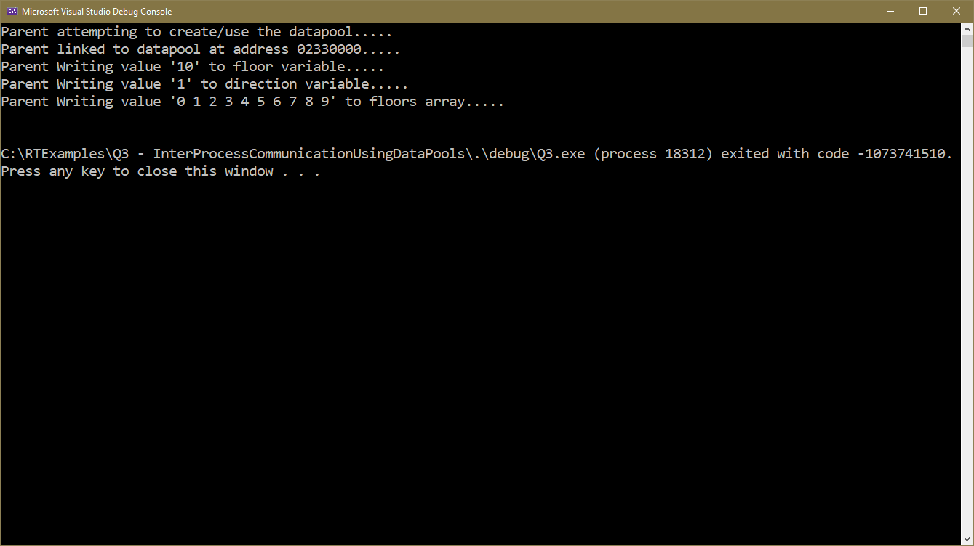
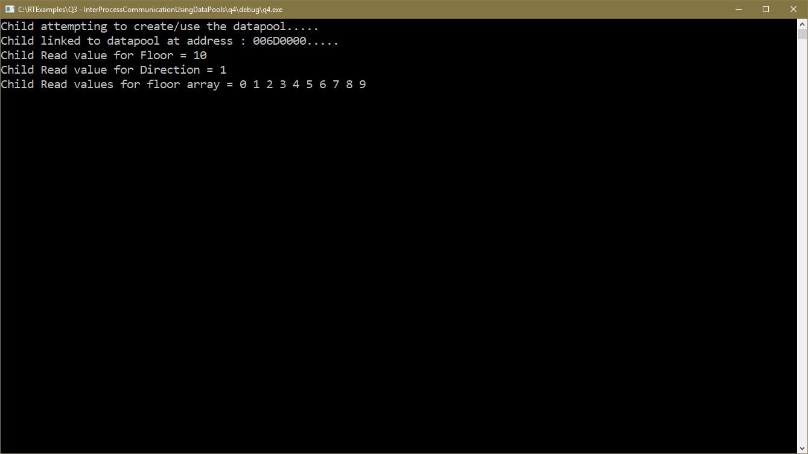
Output of Program Q3/Q4 from RTExamples folder.
Q3 is the Parent, Q4 is the Child. Make sure you rebuild both first.
Question: Why do the addresses of the 2 Datapools not match in the above programs? Look up the concept of “Virtual Memory” and “Address Translation” in OS’es

Slide 26
Drawbacks to the use of Shared Memory and Datapools
Shared Memory and Datapools are very useful when several processes all wish to share the same data amongst themselves, however they need careful management. For example
  There is no built in synchronisation mechanism to prevent two or more processes updating the data at the same time.
  Furthermore, a process reading the data while it is being changed by another process could result in the process reading a mixture of old or partly updated data.
  Shared Memory concepts do not lend themselves very well to communication between processes in a distributed (i.e. networked) environment because
    Their implementation relies on the fact that processes are able to share the same physical memory, i.e. use a pointer to access the data
    The model of a data pool is one that supports random access to data in conjunction with a non-destructive read, which is not easy to translate to a networked environment.
    You cannot share or put any kind of pointer inside shared memory since it will point back to the memory space of the process that put it there, the process reading it out will not be able to use it.

Slide 27
Other Libraries that Support Shared Memory or Data Pools
Supporting Shared Memory with WINDOWS
An example of direct memory sharing under Windows can be found here https://docs.microsoft.com/en-us/windows/desktop/memory/creating-named-shared-memory
Supporting Shared Memory with POSIX and LINUX
The concept of a data pool/shared memory is supported in POSIX and LINUX: see here https://www.softprayog.in/programming/interprocess-communication-using-posix-shared-memory-in-linux
Supporting Shared Memory with BOOST
https://www.boost.org/doc/libs/1_55_0/doc/html/interprocess/sharedmemorybetweenprocesses.html

